Slide 1
Interactive Training Guides
Get Started

Slide 2
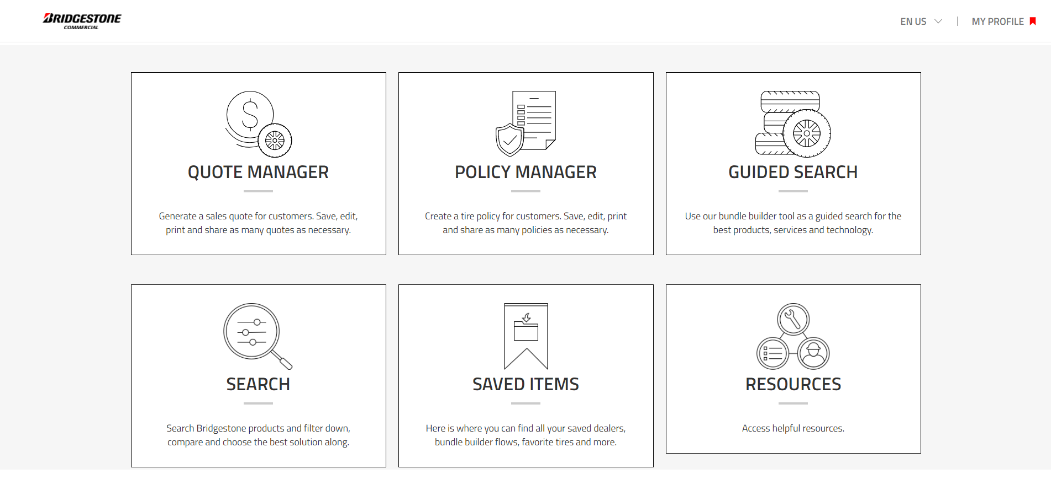
The main dashboard has 6 options, Quote Manager, Policy Manager, Guided Search, Search, Saved Items and Resources. Click each to explore and come back to this back by clicking the Tire Advisor logo on the top right of each page.

Slide 3
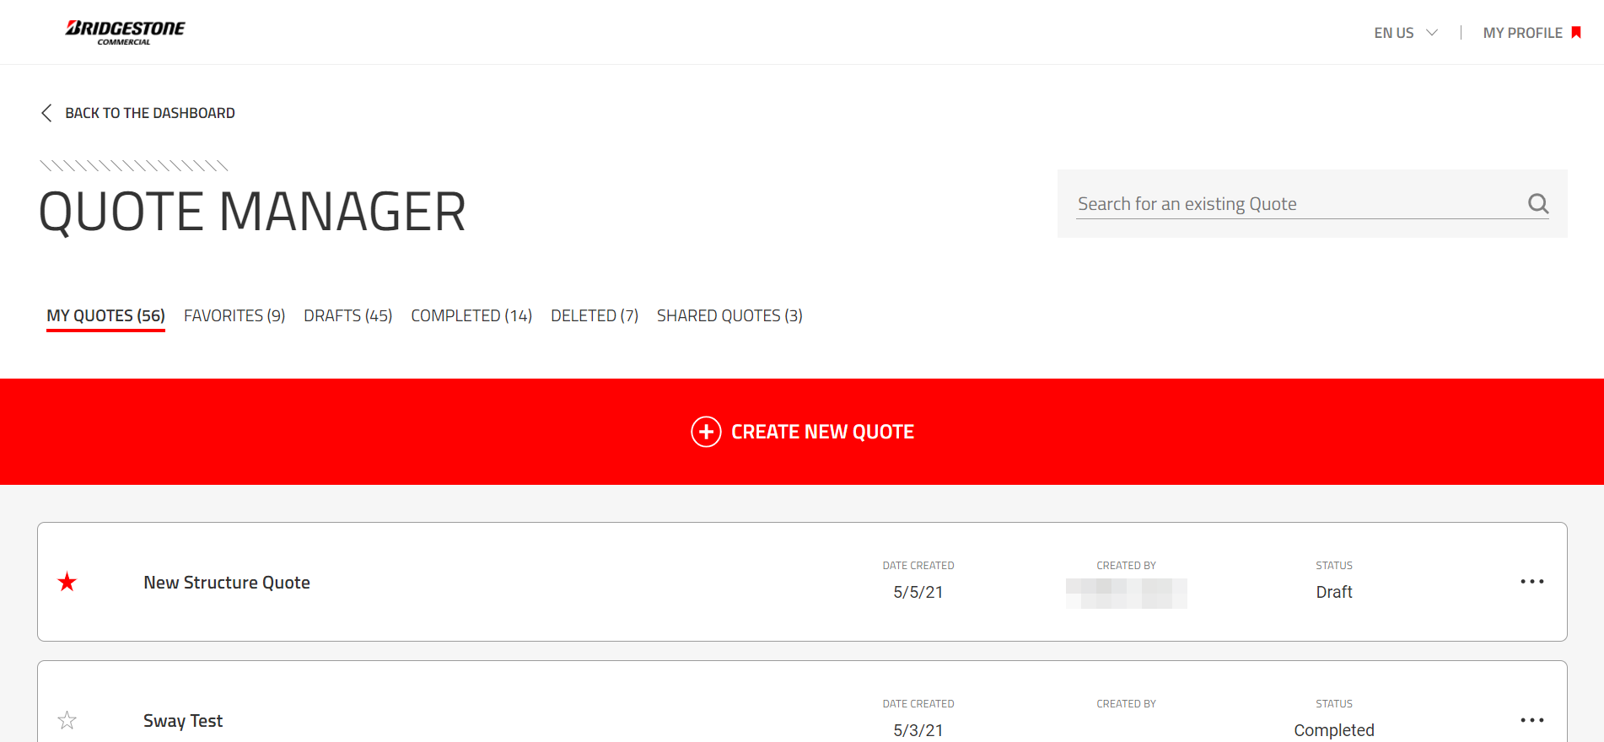
The main Quote Manager page now shows favorited, drafts, completed, deleted and shared quotes. My Quotes will display all quotes and the Search box on the top right allows you to use keywords to search for quotes.

Slide 4
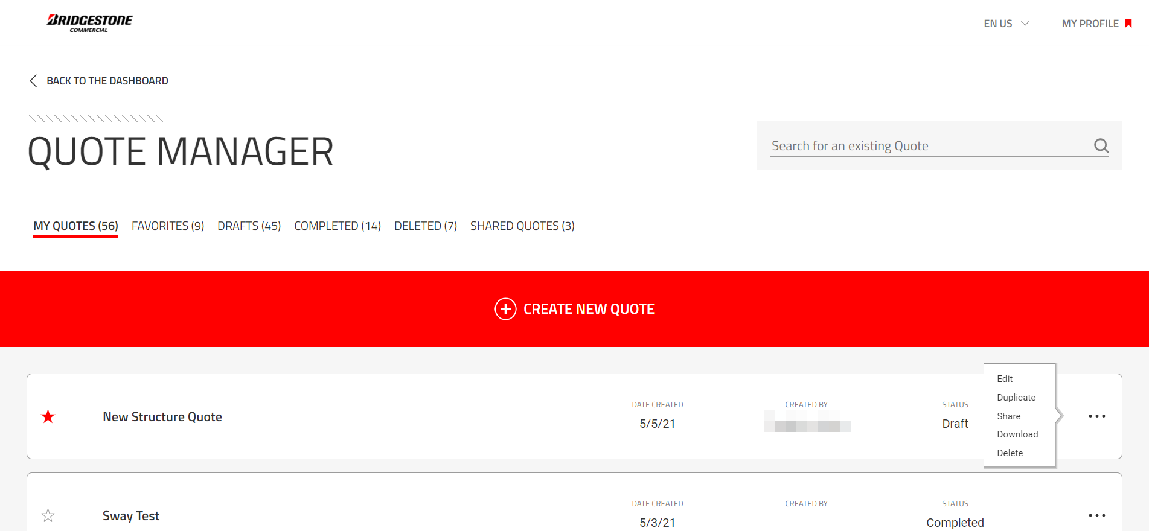
Clicking the 3 dots to the right of the quote also allows the ability to Edit, Duplicate, Share, Download and delete the quote.

Slide 5
In addition, theirs a Back to the Dashboard link on the top left that takes you back to the main dashboard. Go to the next page to view the process of Sharing an event.

Slide 6
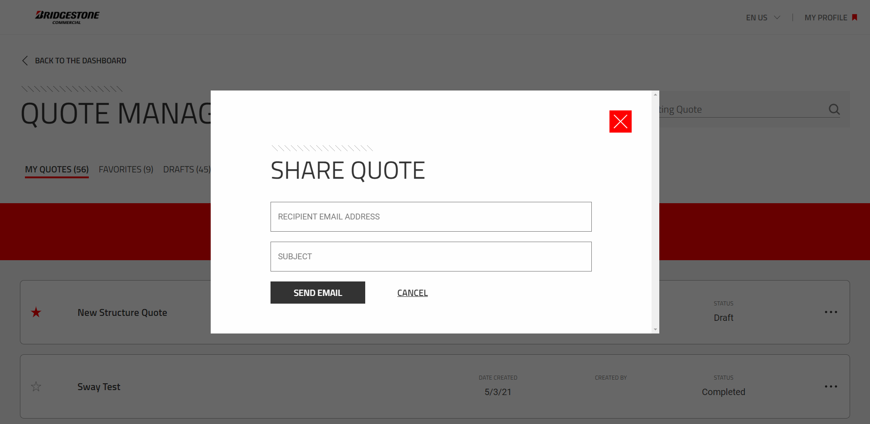
When Sharing a Quote, this can only be done with internal Bridgestone Teammates. Enter the email address and click Send Email.

Slide 7
When editing a Quote, all changes made will automatically be saved to the existing quote. Clicking Create New Quote will initiate a new Quote which will continue in the following pages.

Slide 8
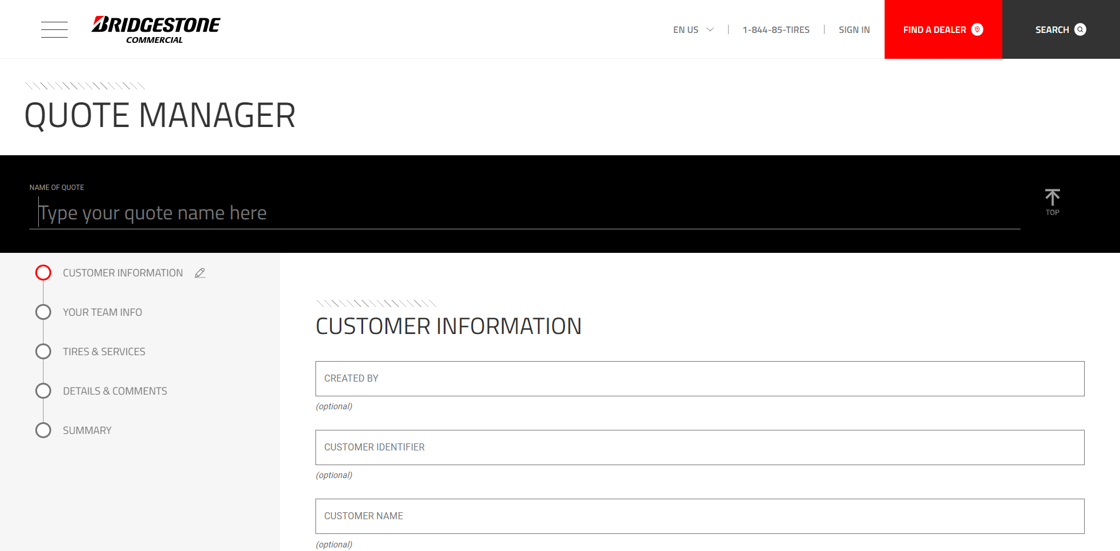
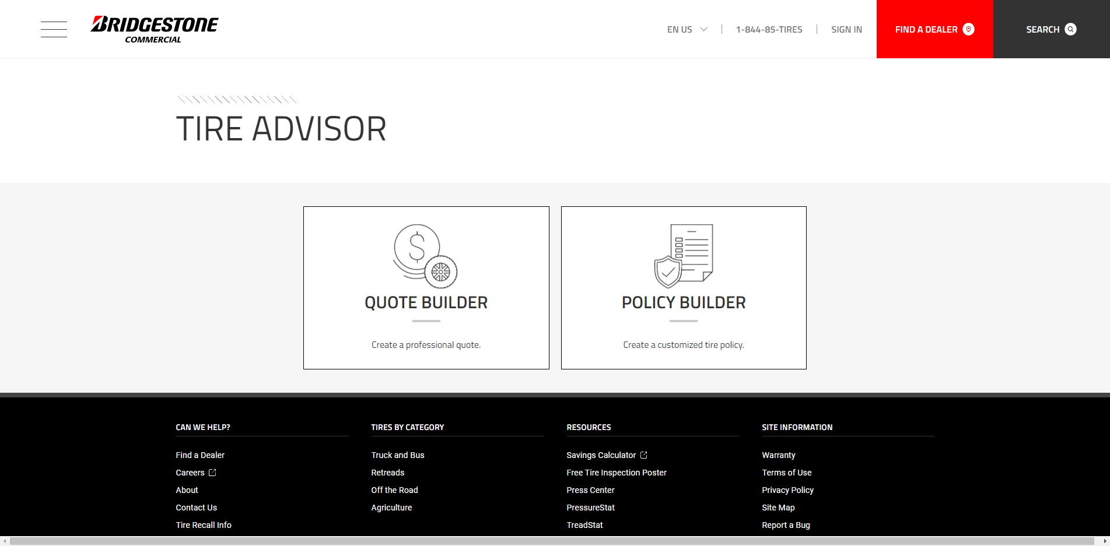
At any time, the ability to click on a section on the left will take you to the start of that section. This will be available throughout the guide. Also, clicking the Tire Advisor logo on the top right will take you back to the main splash page.

Slide 9
Start the Quote by first typing the name of the quote in the “Name of Quote” section. Try to be specific in using content like Customer Name/Location and date(Bob’s Trucking 3.9.2021). Once complete, click enter or tab.

Slide 10
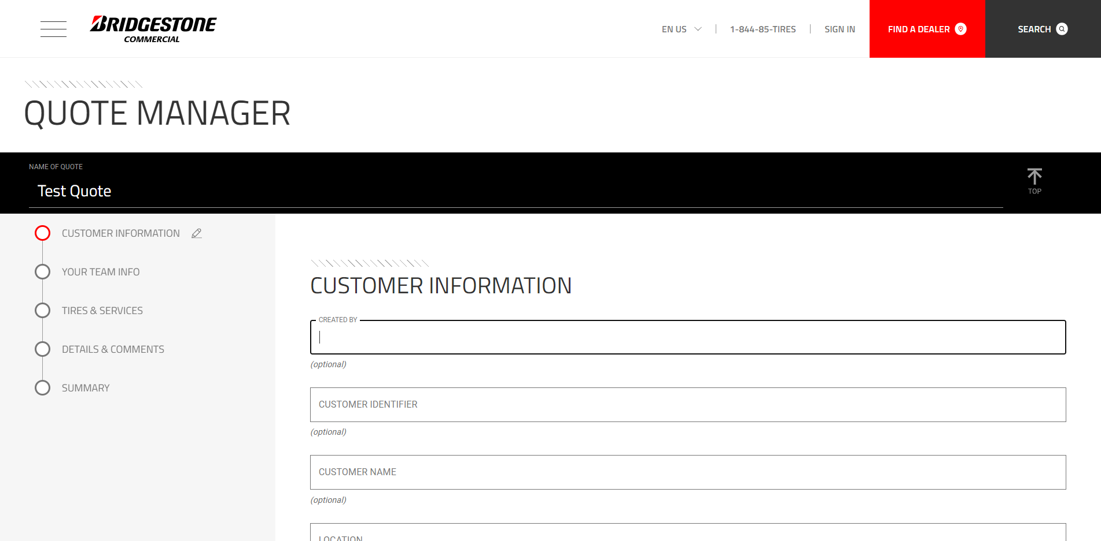
Then proceed to entering general Customer Information seen here on the screen.

Slide 11
When reaching Quote Type, click the drop down to display options.

Slide 12
For Quote Type, two options display with the majority of the use being Standard, but One Time Only will address a single bulk purchase.

Slide 13
The next section will be Product Type with the lone option being Truck Tires. Note: Other business units will be added in future updates.

Slide 14
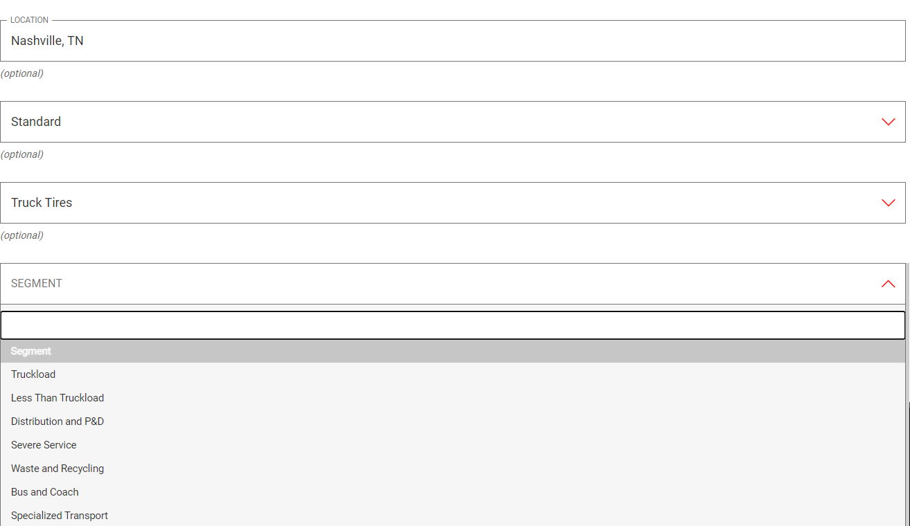
Within the Segment section, a variety of options display. Select the appropriate option for this quote.

Slide 15
All content within this section is optional, but recommended to ensure information and quote is represented accurately. After all Customer Information is complete, click on the next section Team Info.

Slide 16
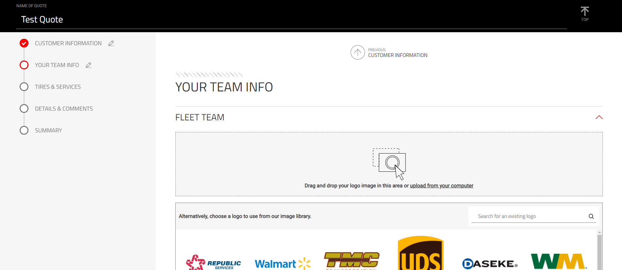
After each section, the ability to go back to the Previous section is available at the top of each page.

Slide 17
The next section will involve entering the Team Info for the quote. To insert a logo, the first option is to upload from a computer. To do this click upload from your computer.

Slide 18
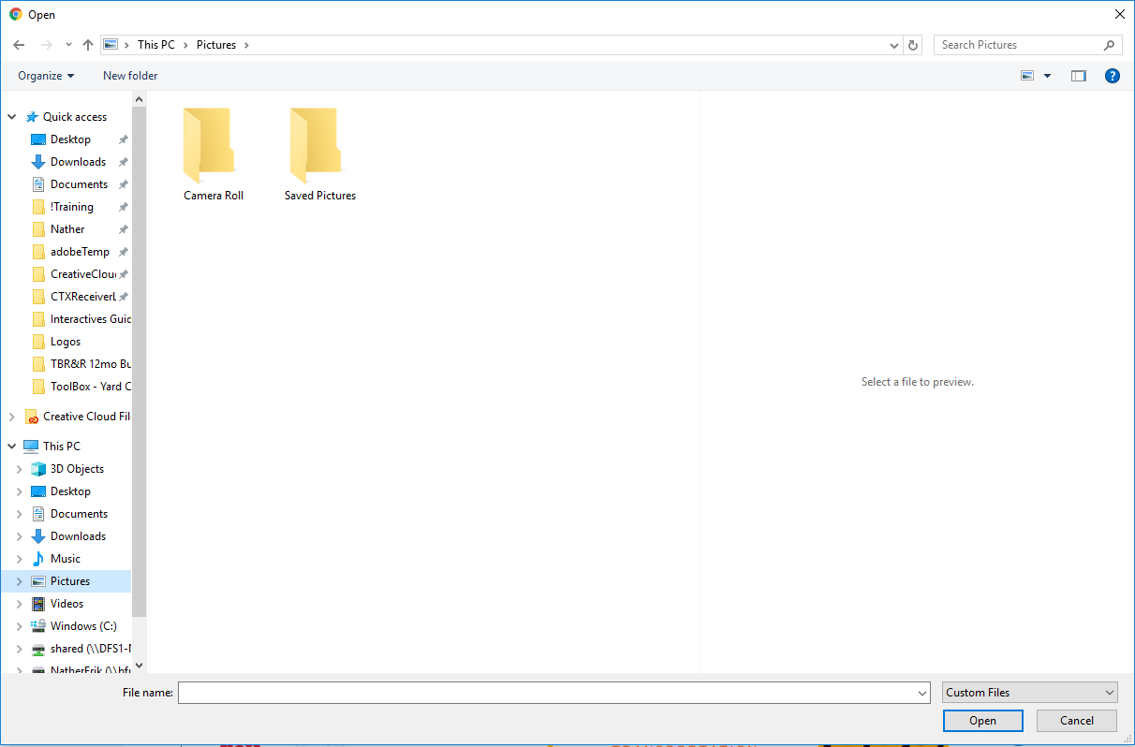
This will populate a file explorer on your computer. Find the image file and click Open.

Slide 19
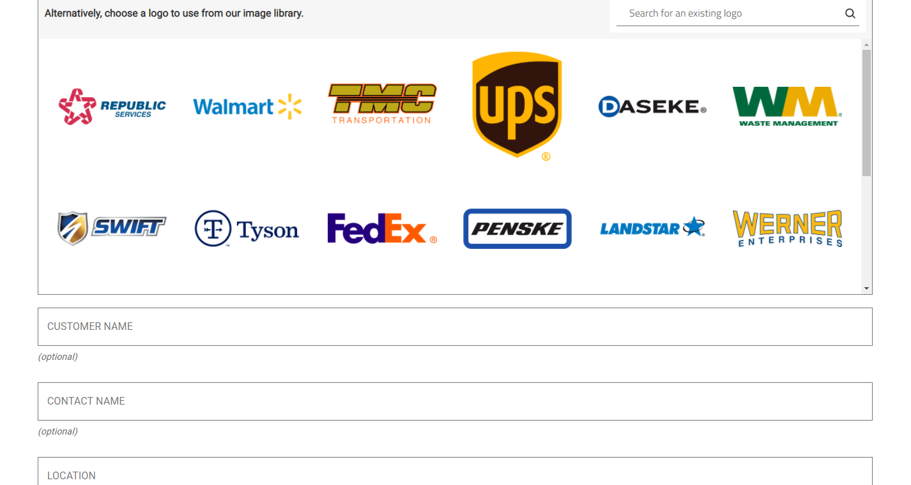
There’s also an image library that can be searched via the search box. Once logo is located, click the logo, and then click Use this Logo to add to quote

Slide 20
After inserting the optional logo, fill out the Fleet Customer Name, Contact Name, and location.

Slide 21
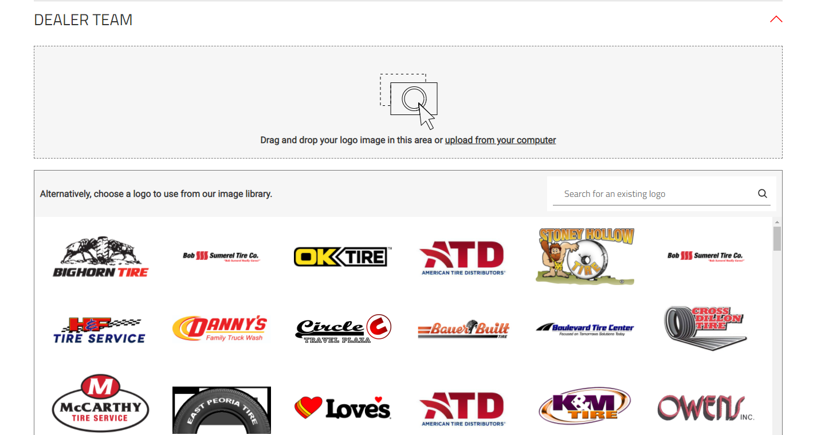
After the Fleet information, we would do the same with the Dealer Team. Either insert a logo from your computer or search to add a logo for the Dealer on the quote.

Slide 22
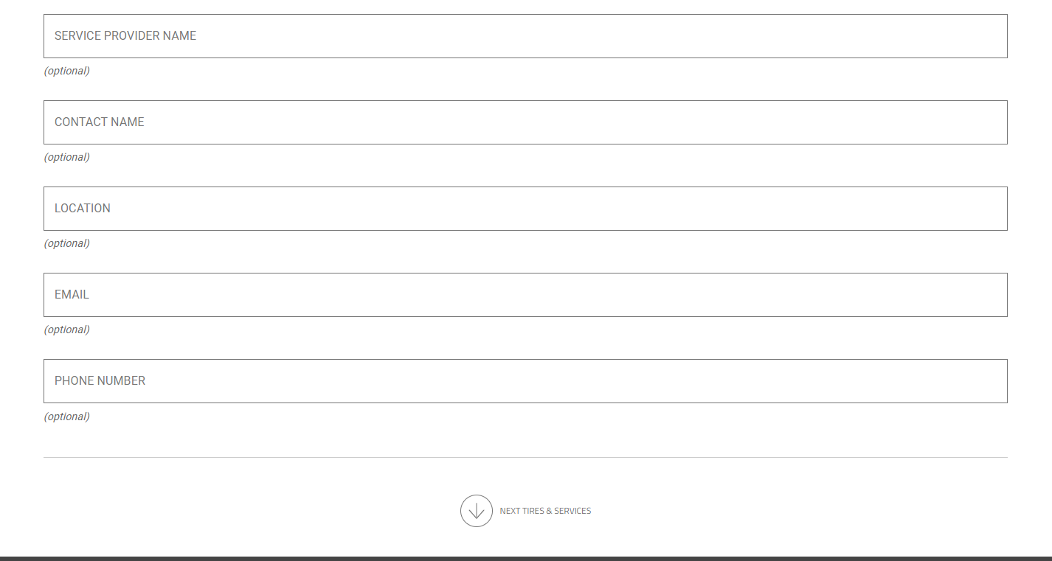
Once logos are added, go through and fill out as much of the Dealer information as possible via the options shown here. After all information is added, click the arrow on the bottom to begin entering Tires and Services

Slide 23
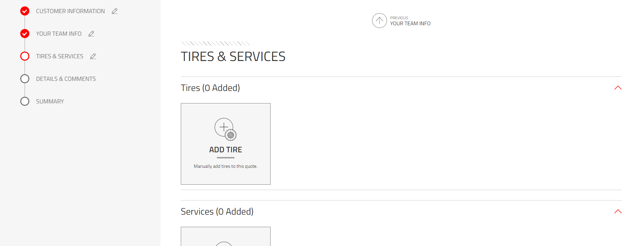
Tires and Services can be added to the quote in this section. Let’s first look at adding a Tire by clicking on the ADD TIRE button.

Slide 24
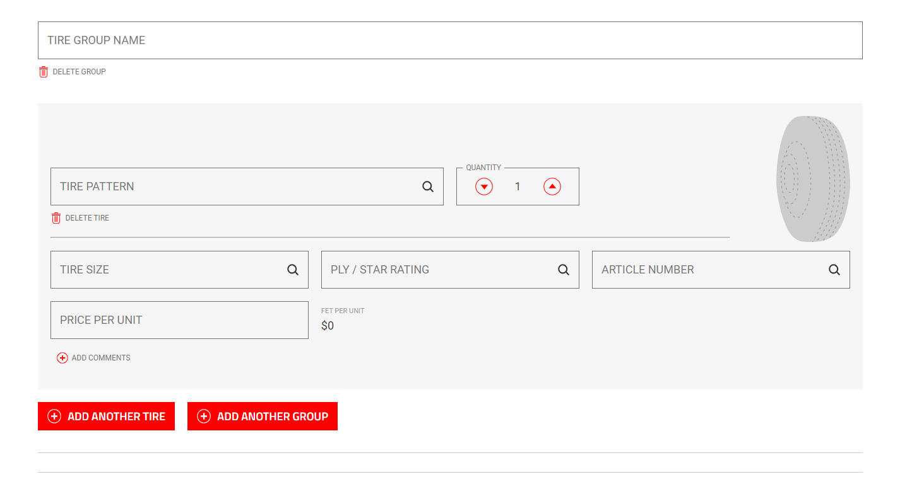
Tires can be grouped if desired. Example: Steers Tires, Drive Tires, Trailer Tires. Once a Tire Group name is added, start by entering in the tire information shown.

Slide 25
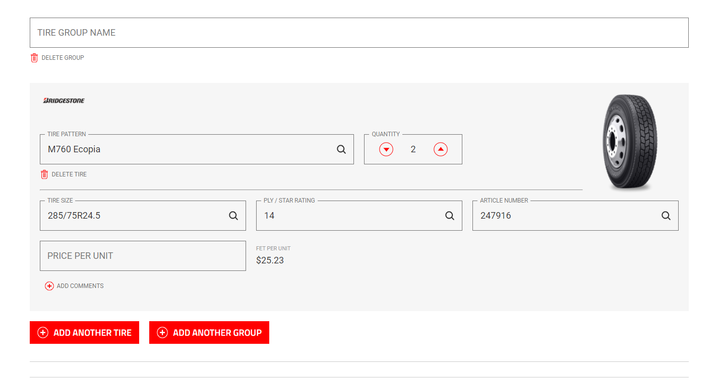
Tires can also simply be added by adding an Article Number. Keep in mind that if either Tire Pattern or Article Number is removed, all other data will be as well.

Slide 26
The quickest way to populate is to use the article number. TA does not read leading 0s when using the article number. Price per unit is BEFORE FET. The FET will be added to the price on the output. In addition, input comments identifying what wheel position and application the tire is used in. I.e. M760 is a line haul, Smartway Approved, drive tire. Any other key features specific to the customer’s application should be mentioned.

Slide 27
If another Tire and Group need to be added, click on the corresponding buttons and repeat the process we just went over to add Tires to the quotes.

Slide 28
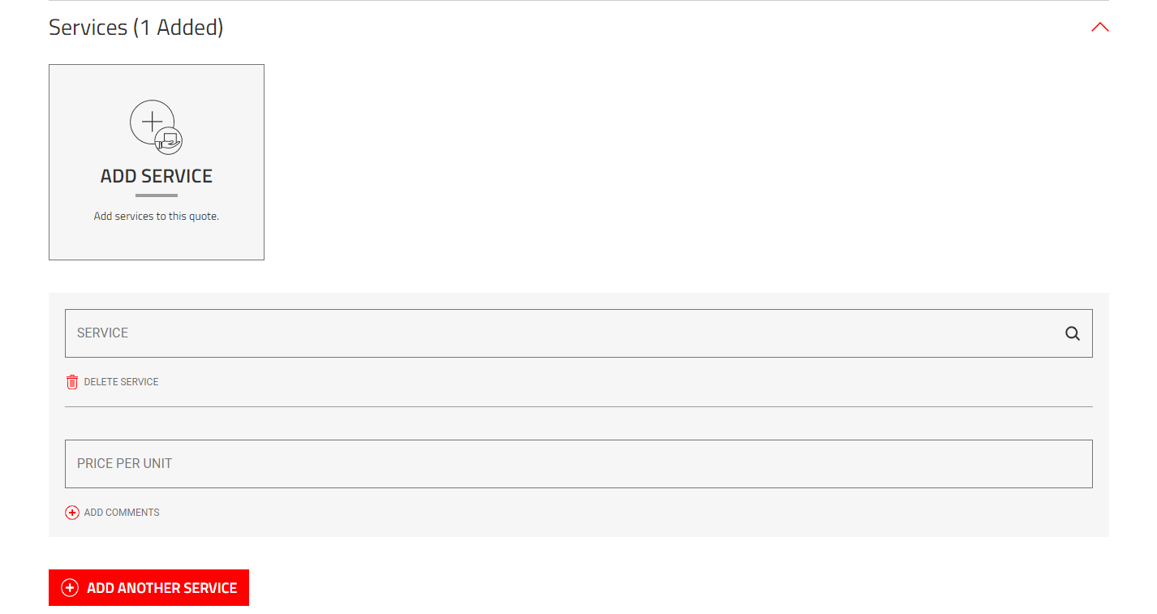
When the ADD SERVICE button is clicked, the option to search or manually enter a service and quote becomes available. Only onc service at a time can be added, so if another one needs to be added, click ADD ANOTHER SERVICE.

Slide 29
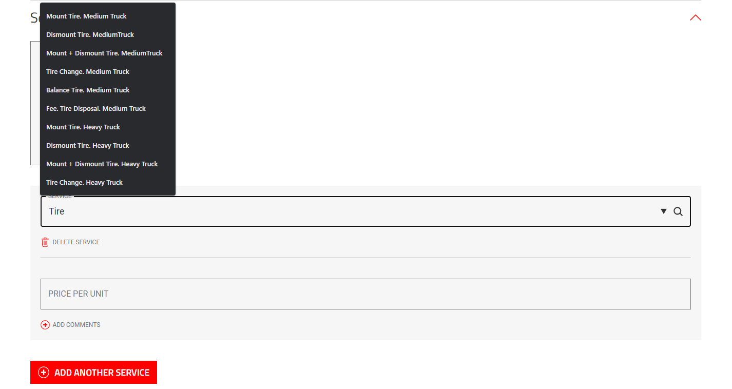
When using the Service box, enter in a keyword and available services based on the keyword will display. Example shown here based on Tire.

Slide 30
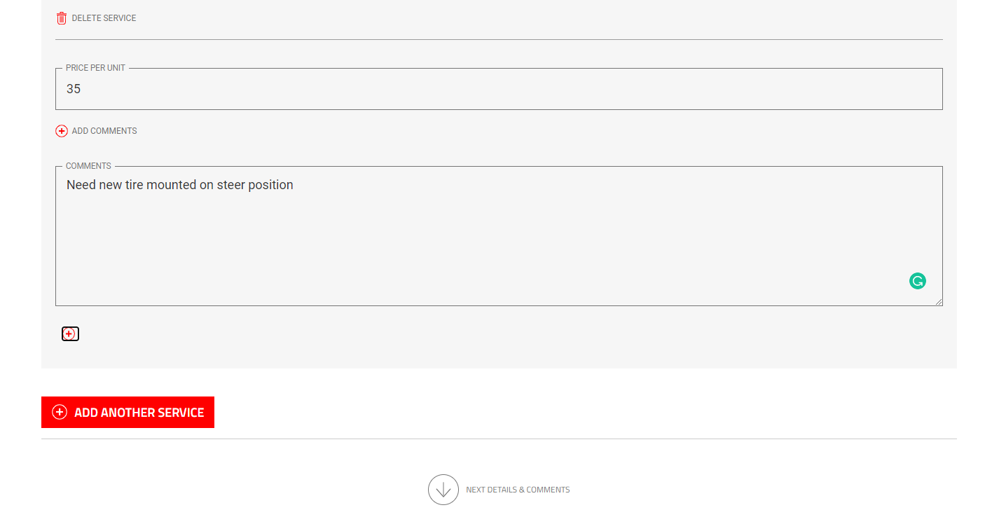
Clicking ADD COMMENTS will allow for more details to be added to service. Only once service at a time can be added, so if another one needs to be added, click ADD ANOTHER SERVICE.

Slide 31
Based off the National Account YY code descriptions. Be sure to include notes in ‘add comments’ like “includes valve stem and flow-thru” for a mounted wheel or two-hour minimum for Emergency Road Service. Also differentiate your company here or include any date parameters on pricing.

Slide 32
After all Tires and Services have been added to the Quote, click the arrow on the bottom to go to the next section, Details and Comments

Slide 33
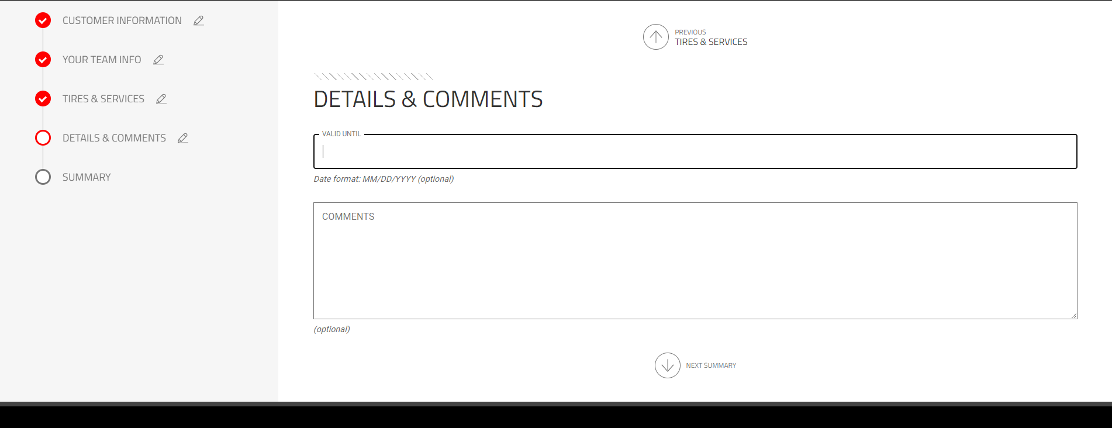
The Details & Comments sections allows for the entry of a Valid Until date and any other comments. Once complete click the arrow on the bottom for the next section, Summary.

Slide 34
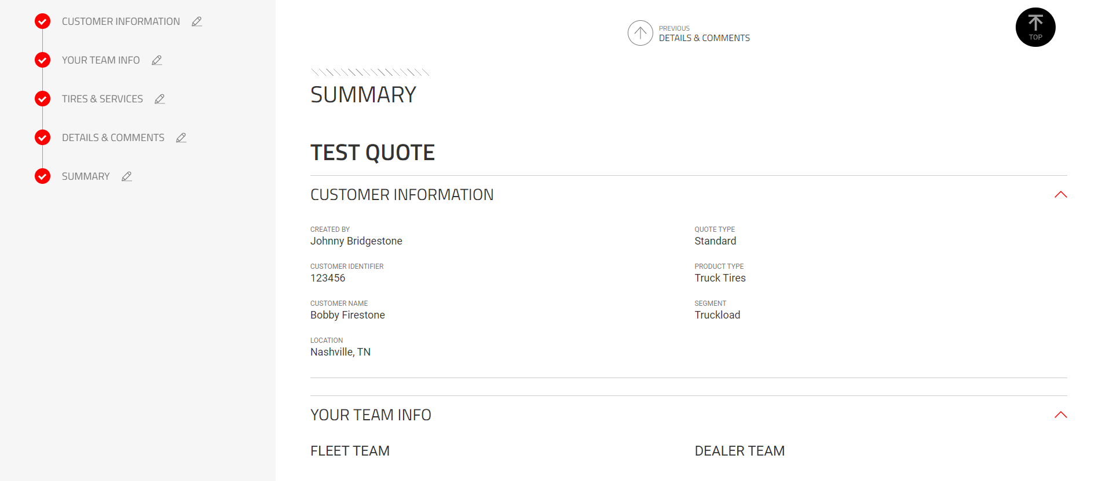
The Summary will show all information added within the Quote starting with the Customer and Team Info.

Slide 35
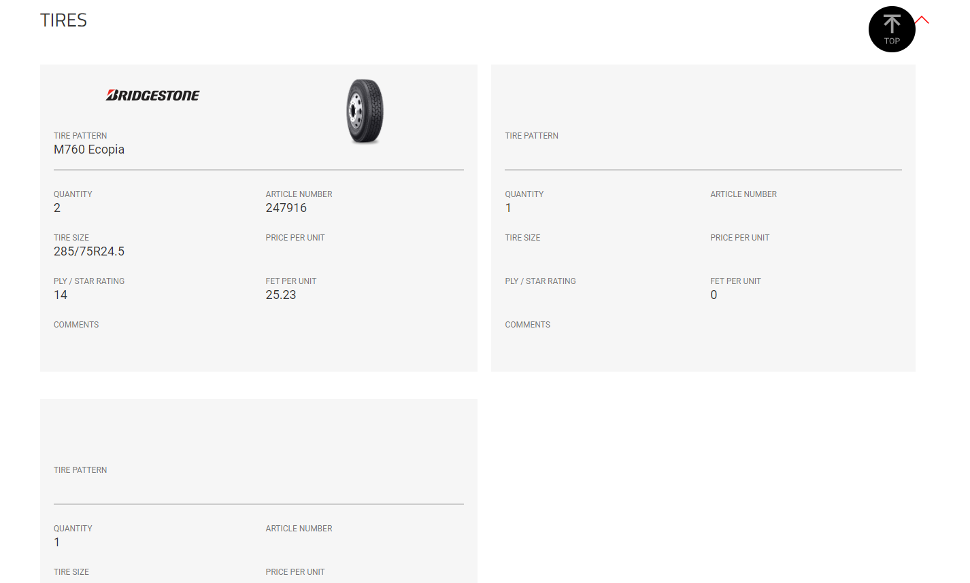
Next part of the summary will detail out all Tires added to the Quote

Slide 36
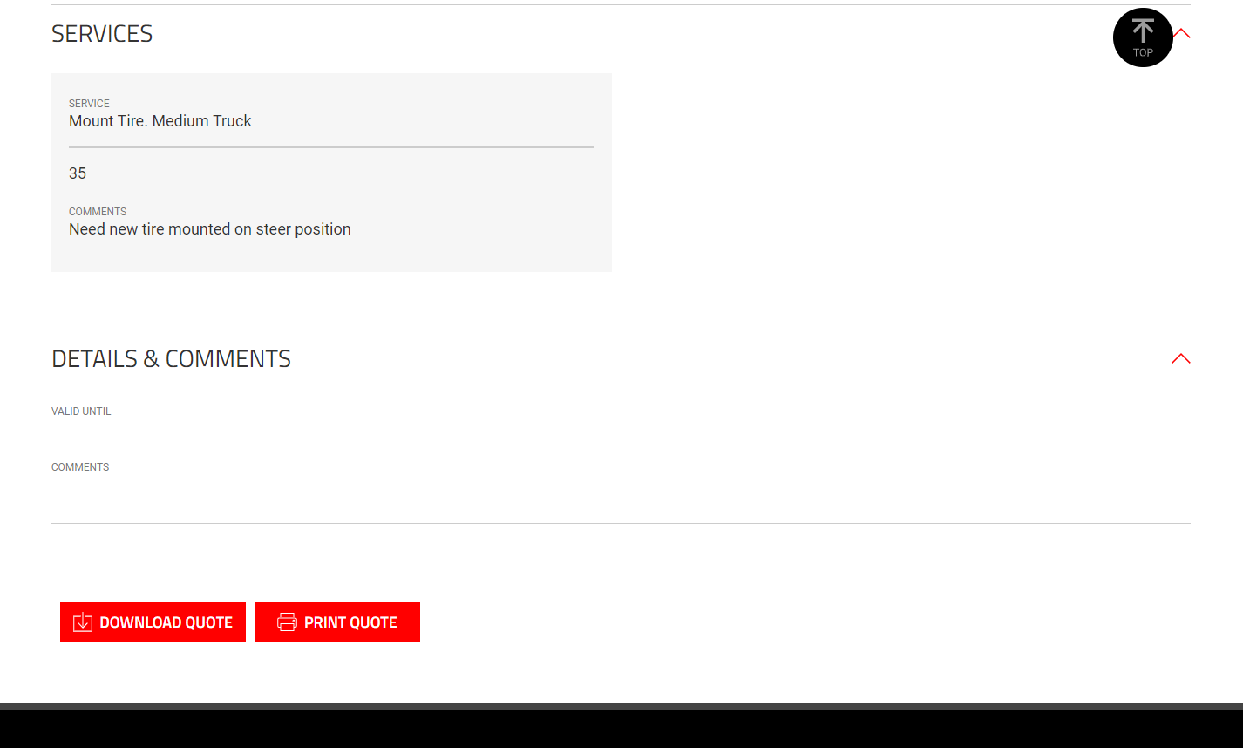
And the final section will detail out the Services, Details and Comments left on the quote.

Slide 37
Retread and Repairs will wrap it up, but as shown, when no information is entered or selected, the field will be blank. If a section needs to be reviewed and information added/edited, click on the section on the left and proceed accordingly. This page can always be accessed by clicking on Summary.

Slide 38
At the bottom the option to download and print quote is available. Print Quote will populate any printer options within the computer. Download Quote will download a copy of the quote in a PDF to the computer. Make sure to review carefully before forwarding to the customer.

Slide 39
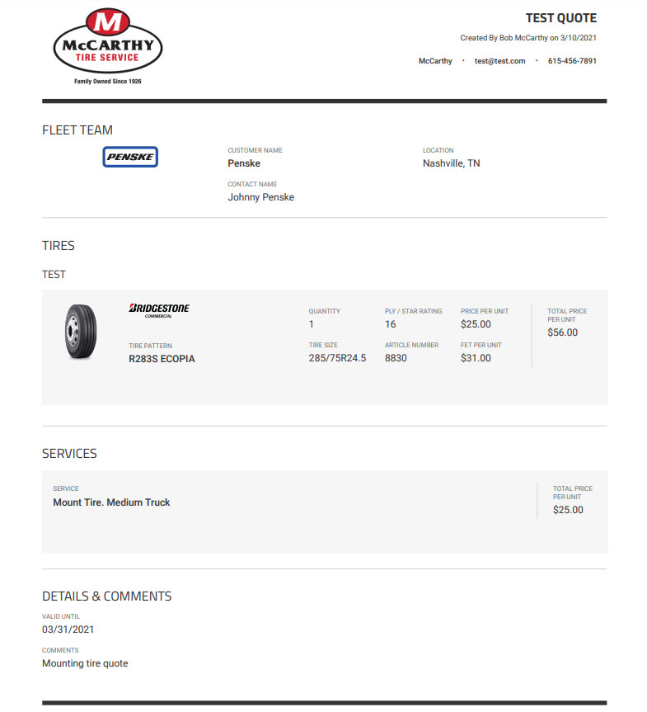
The PDF shown will be going through changes to allow the ability to include most of the Policy on 1 – 3 pages. This concludes the Quote Manager walk through. Explore another section or click the Tire Advisor logo to go back the main home screen.

Slide 40
The main Policy Manager page now shows favorited, drafts, completed, deleted and shared policies. My Policies will display all quotes and the Search box on the top right allows you to use keywords to search for quotes.

Slide 41
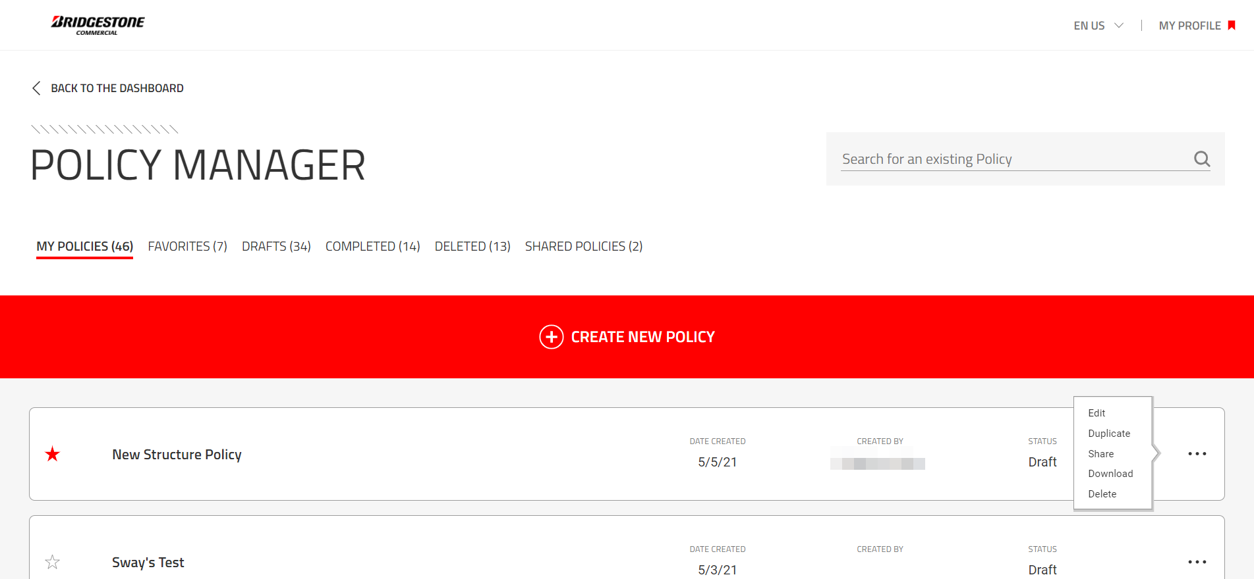
Clicking the 3 dots to the right of the quote also allows the ability to Edit, Duplicate, Share, Download and delete the Policy.

Slide 42
In addition, theirs a Back to the Dashboard link on the top left that takes you back to the main dashboard. Go to the next page to view the process of Sharing an event.

Slide 43
When Sharing a Policy, this can only be done with internal Bridgestone Teammates. Enter the email address and click Send Email.

Slide 44
When editing a policy, all changes made will automatically be saved to the existing quote. Clicking Create New Policy will initiate a new Quote which will continue in the following pages.

Slide 45
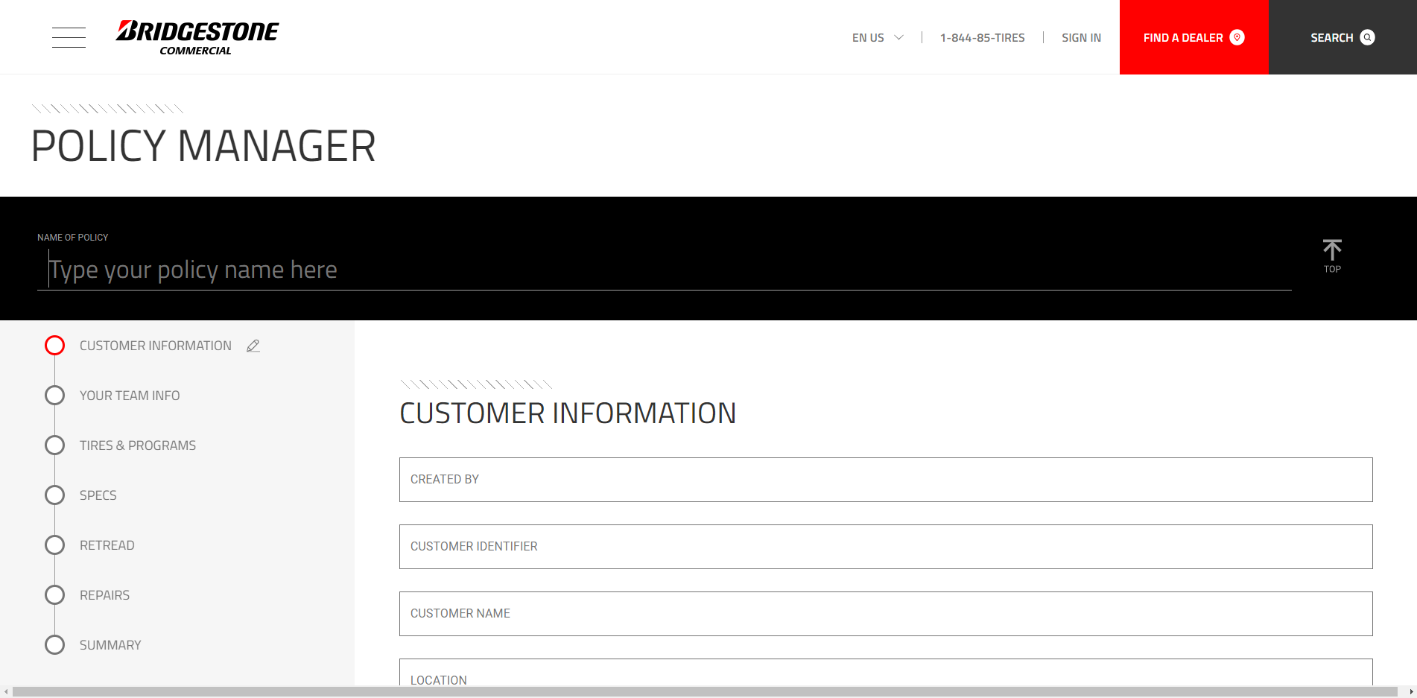
At any time, the ability to click on a section on the left will take you to the start of that section. This will be available throughout the guide. Also, clicking the Tire Advisor logo on the top right will take you back to the main splash page.

Slide 46
Start the Policy by first typing the name of the quote in the “Name of Quote” section. Try to be specific in using content like Customer Name/Location and date(Bob’s Trucking 3.9.2021). Once complete, click enter or tab.

Slide 47
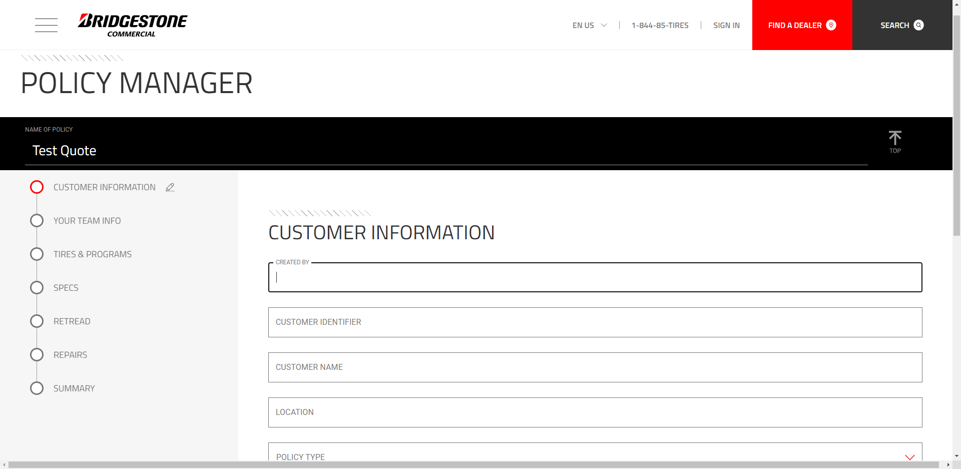
Then proceed to entering general Customer Information seen here on the screen. **IMPORTANT**: Check with your local BCS rep before setting up a NAC customer. It is imperative that we follow specs as outlined with that Fleet’s corporate policy.

Slide 48
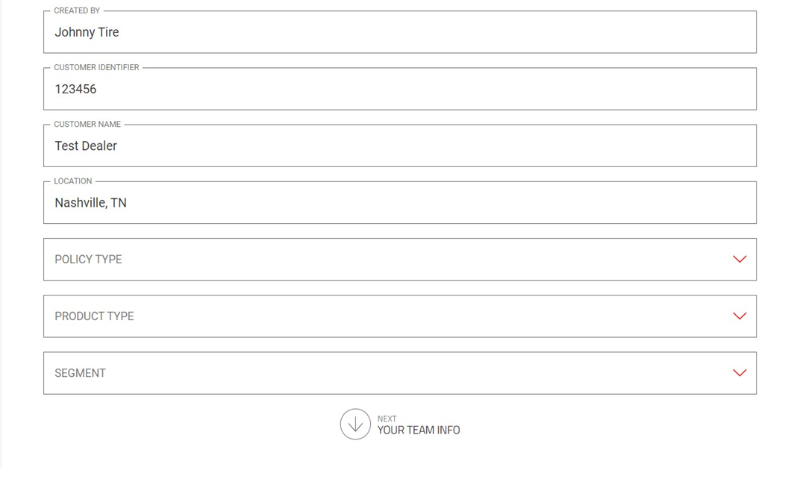
When reaching Policy Type, click the drop down to display options.

Slide 49
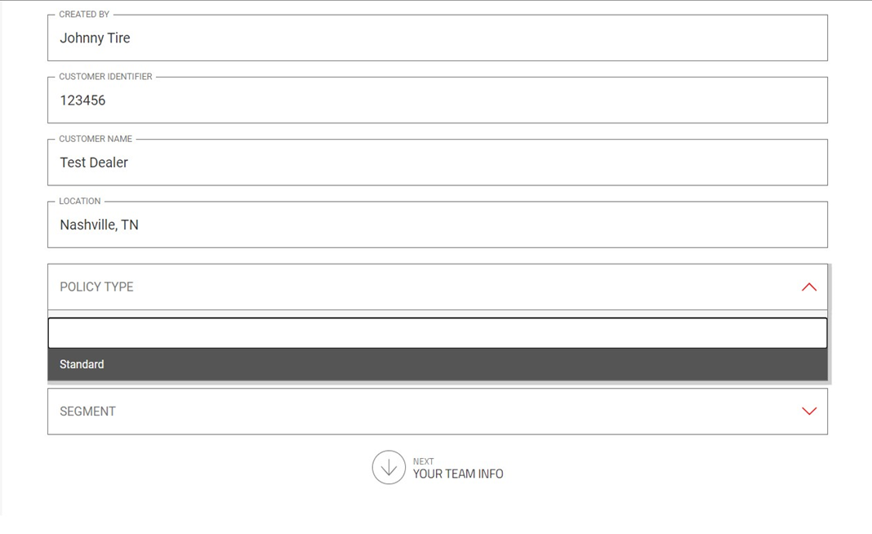
For Policy Type select standard .

Slide 50
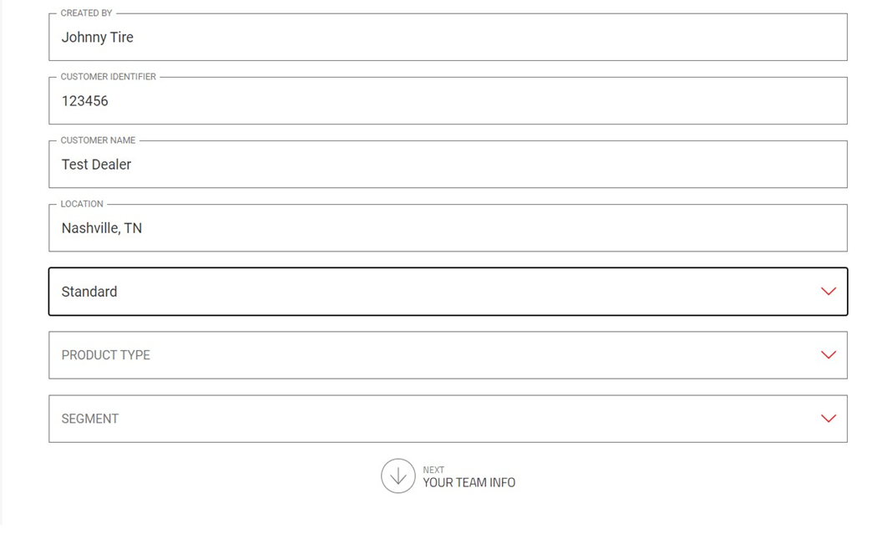
For Product Type, multiple options are available. Select and click the one that fits this policy quote.

Slide 51
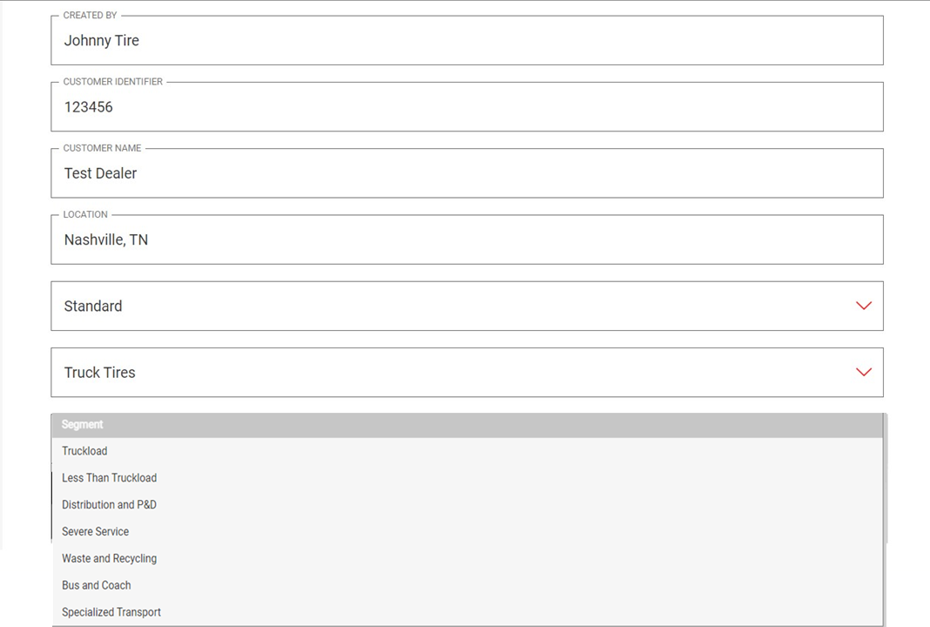
For Segment, the options of Truck Tires and Light Truck are available. Click on one to select.

Slide 52
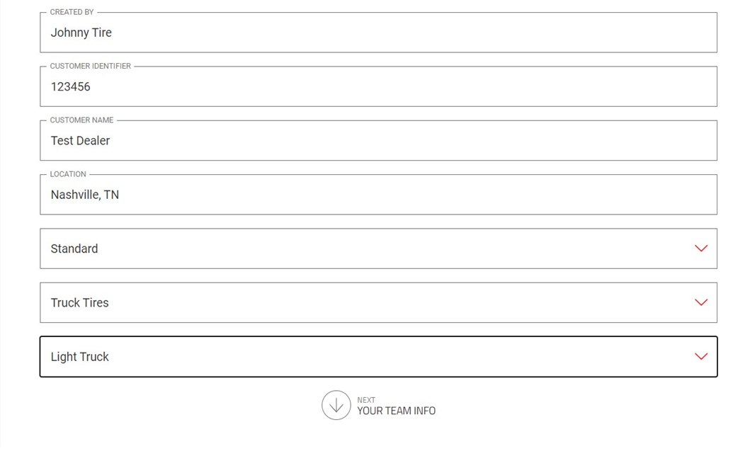
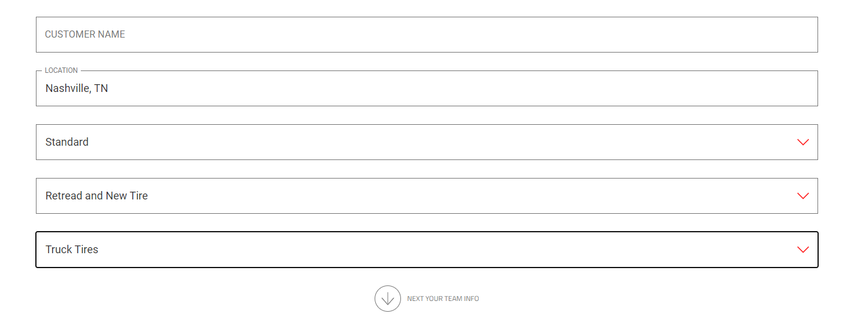
All content within this section is optional, but recommended to ensure information and policy is represented accurately. After all Customer Information is complete, click on the next section Your Team Info.

Slide 53
After each section, the ability to go back to the Previous section is available at the top of each page.

Slide 54
The next section will involve entering the Team Info for the quote. To insert a logo, the first option is to upload from a computer. To do this click upload from your computer.

Slide 55
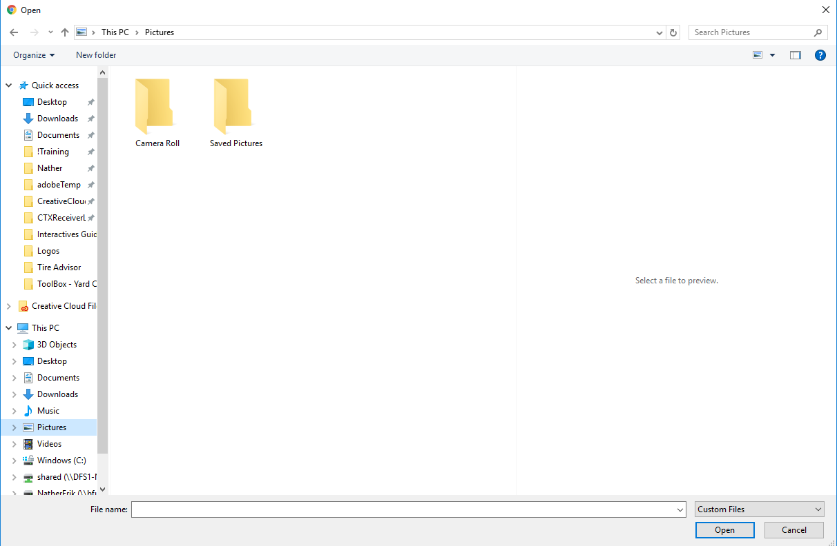
This will populate a file explorer on your computer. Find the image file and click Open.

Slide 56
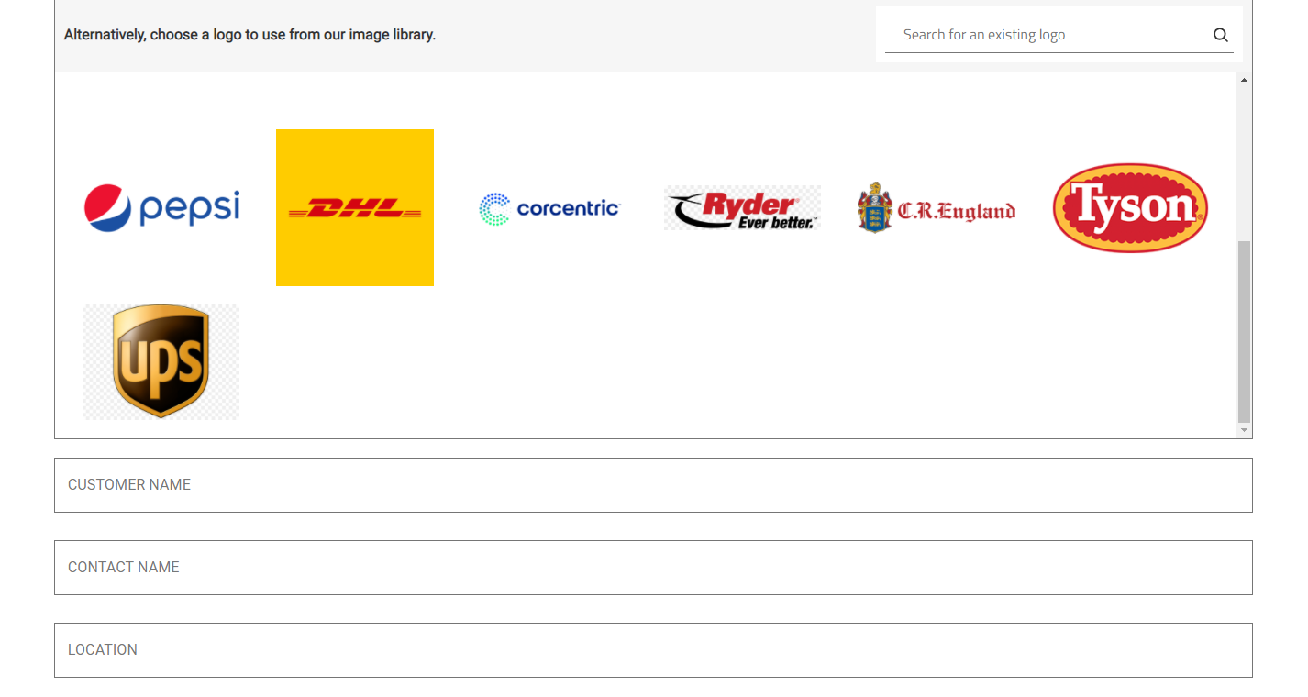
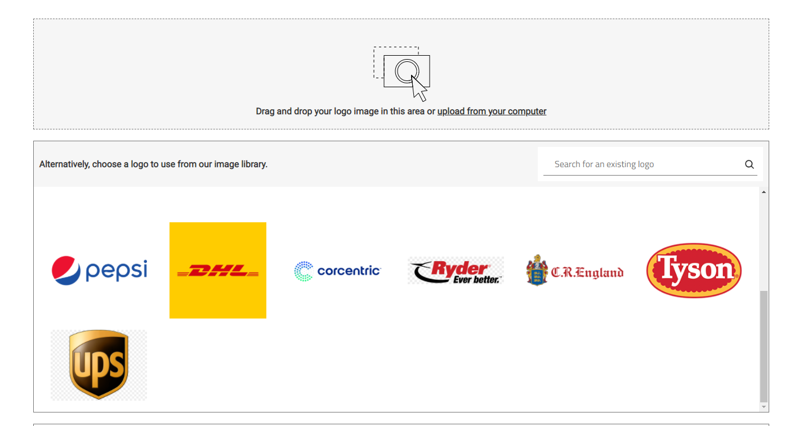
There’s also an image library that can be searched via the search box. Once logo is located, click the logo, and then click Use this Logo to add to quote

Slide 57
After inserting the optional logo, fill out the Fleet Customer Name, Contact Name, and location.

Slide 58
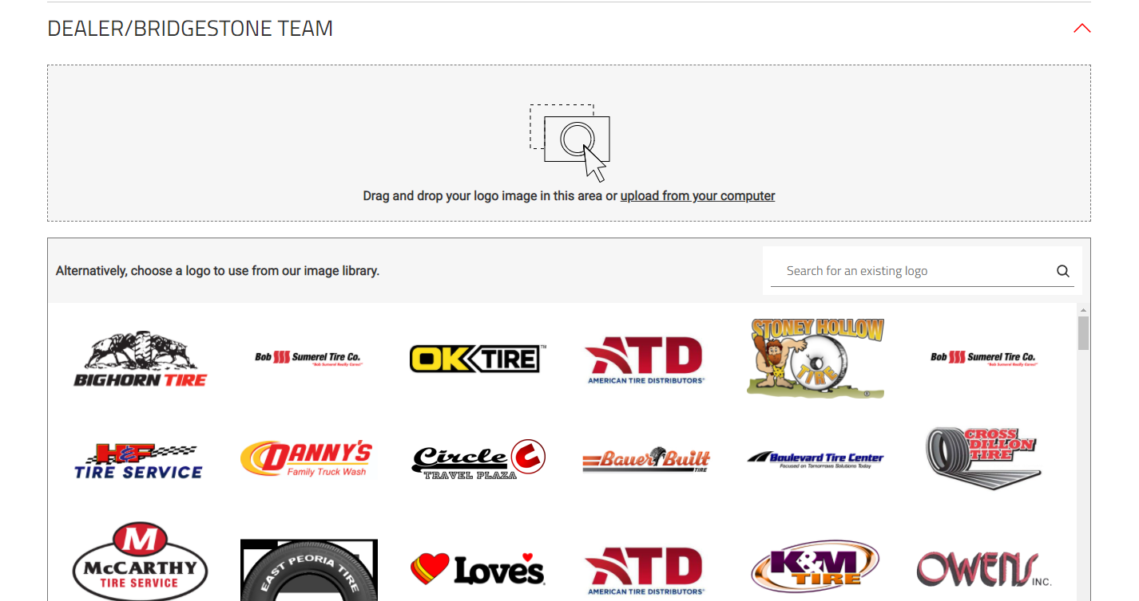
After the Fleet information, we would do the same with the Dealer Bridgestone Team. Either insert a logo from your computer or search to add a logo for the Dealer on the quote.

Slide 59
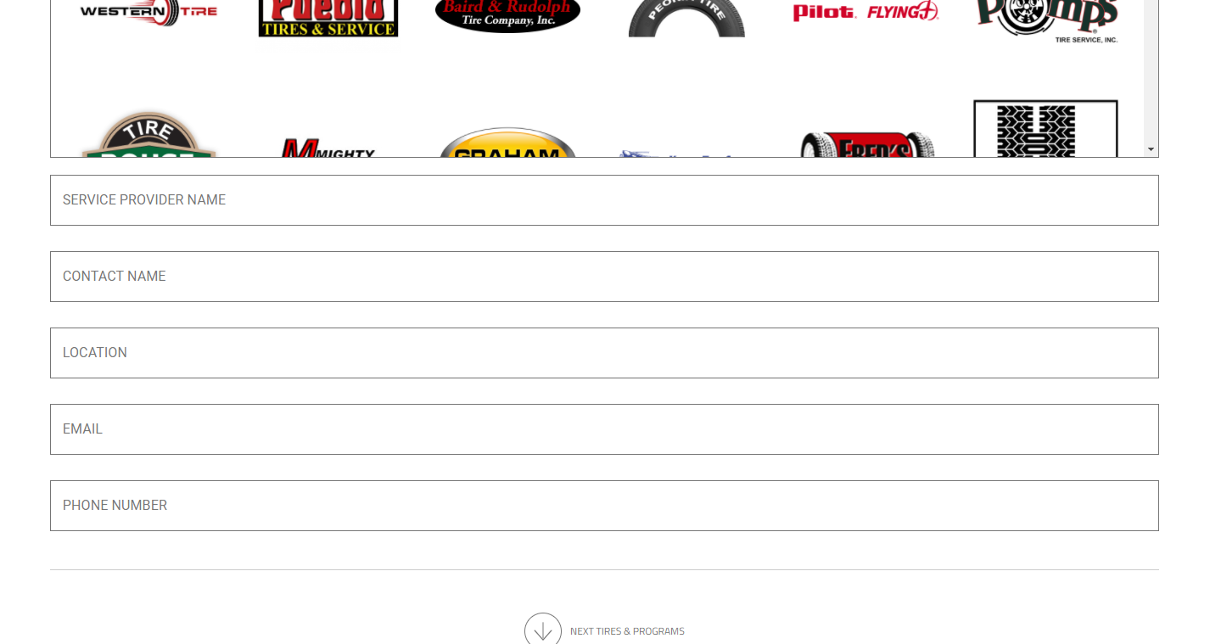
Once logos are added, go through and fill out as much of the Dealer information as possible via the options shown here. After all information is added, click the arrow on the bottom to being entering in Tires and Programs.

Slide 60
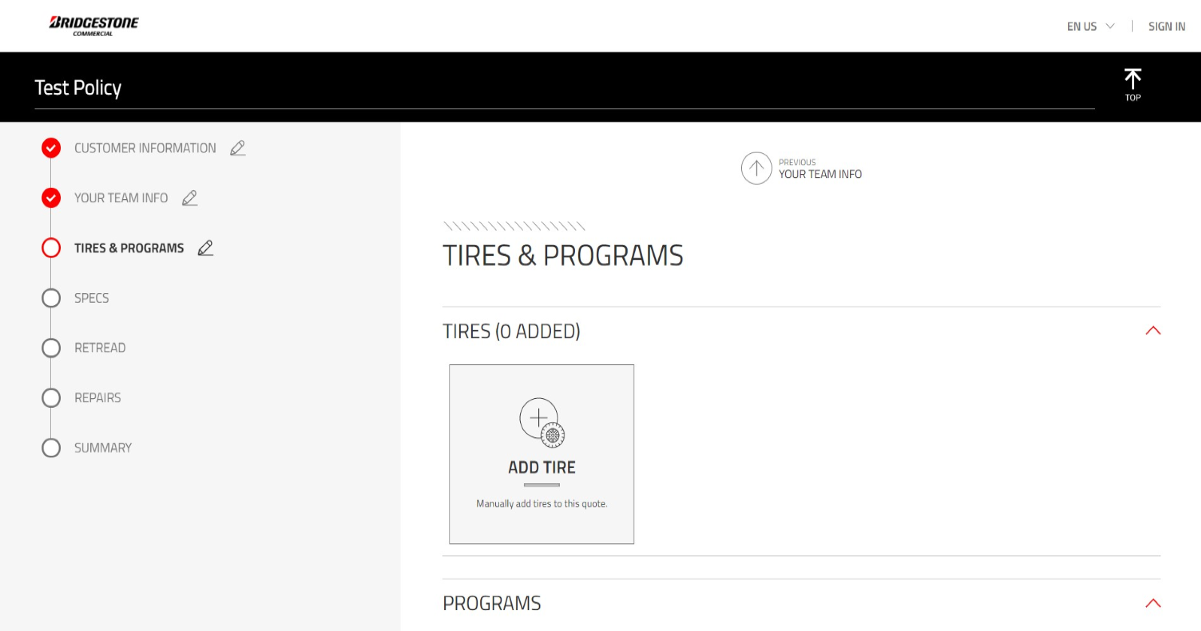
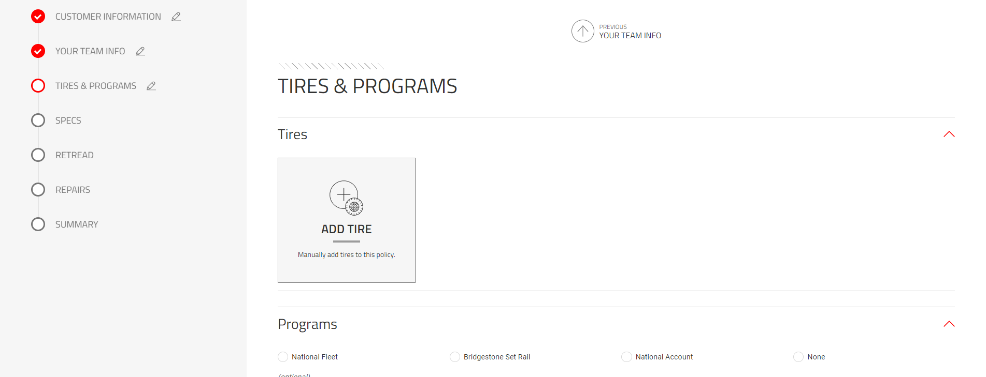
This next section will give the ability to add Tires & Programs to the Policy. Let’s first look at adding a Tire by clicking on the ADD TIRE button.

Slide 61
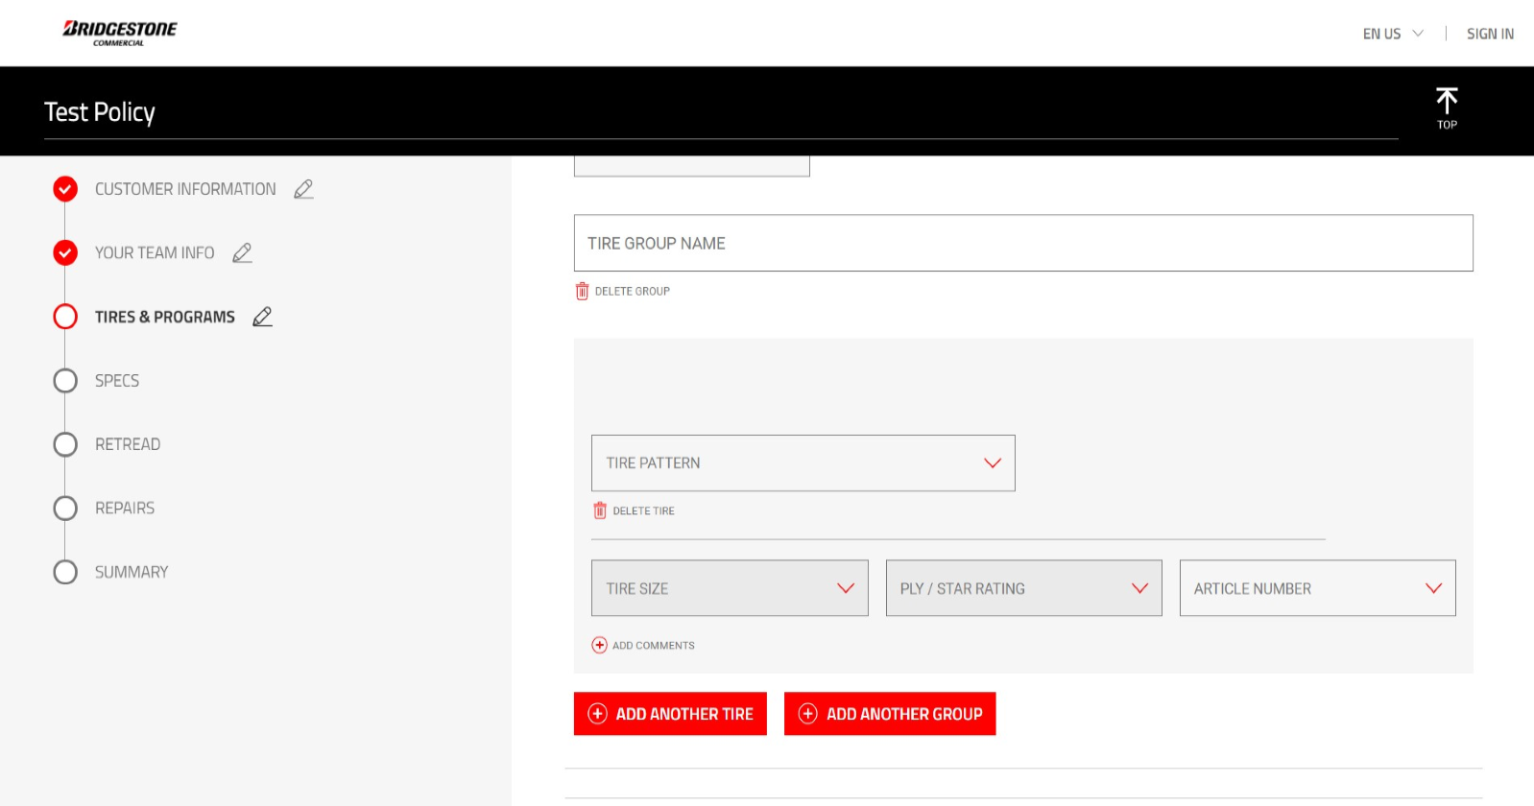
Tires can be grouped if desired. Example: Steers Tires, Drive Tires, Trailer Tires. Once a Tire Group name is added, start by entering in the tire information shown.

Slide 62
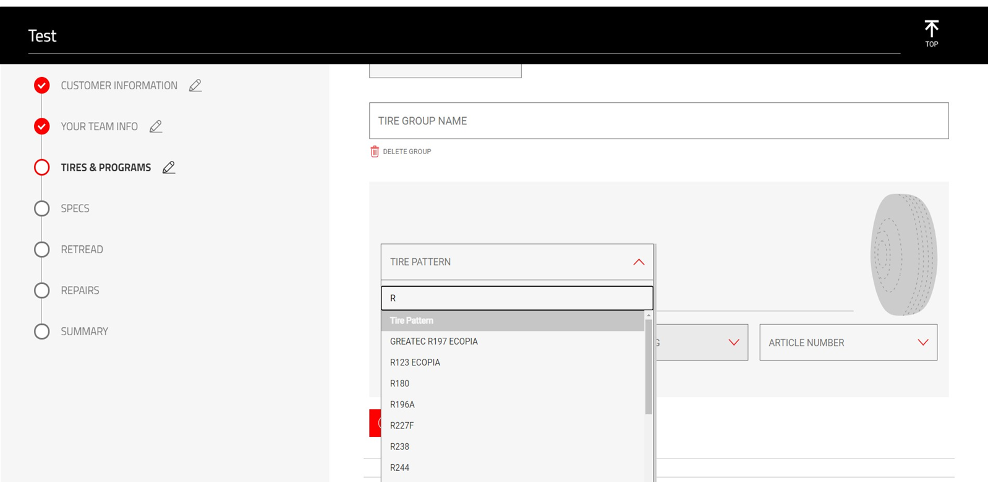
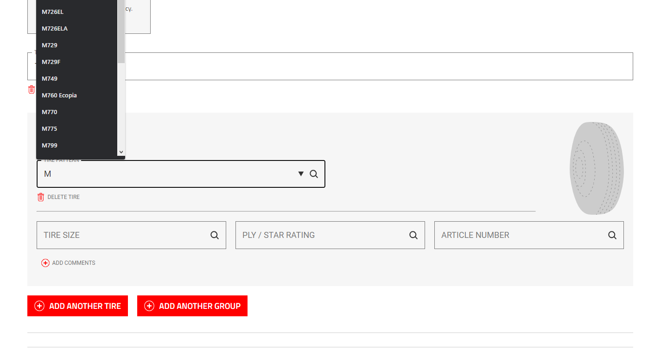
The Tire Pattern box will auto populate Tires based on text entry. Start to type and Patterns that match will display to choose.

Slide 63
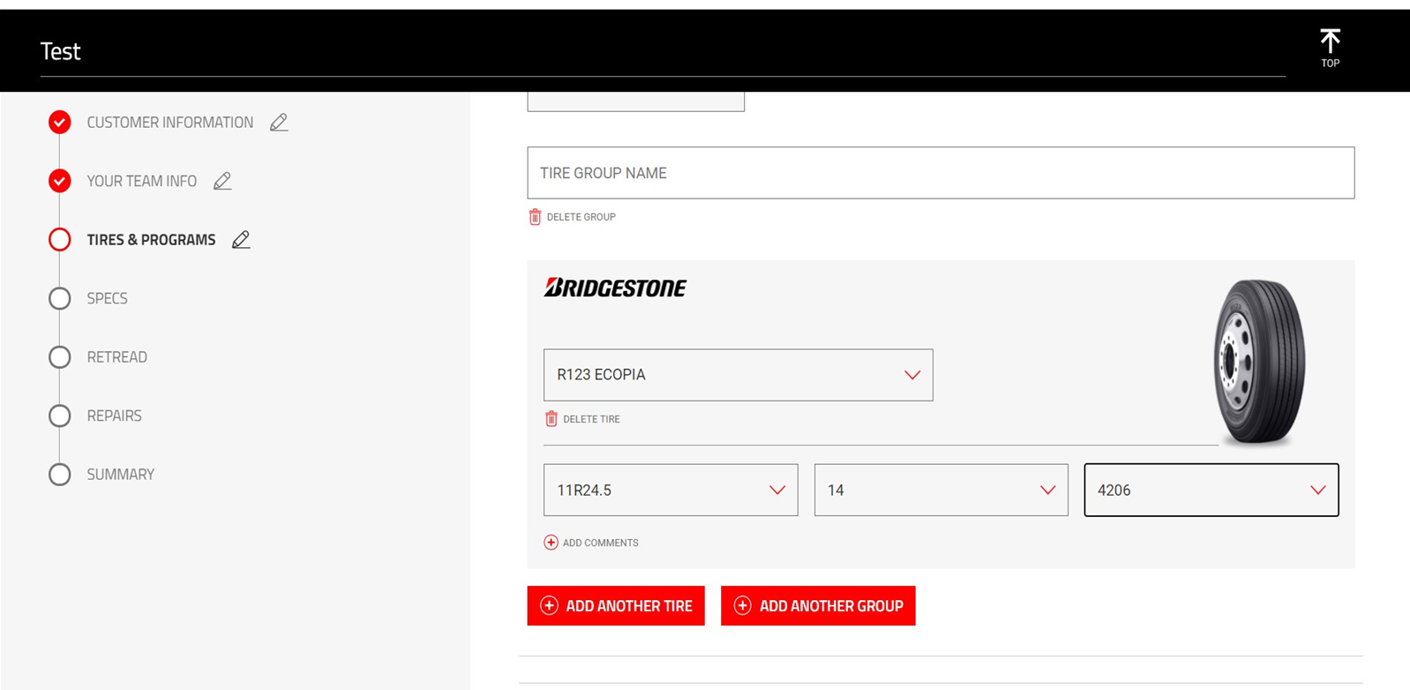
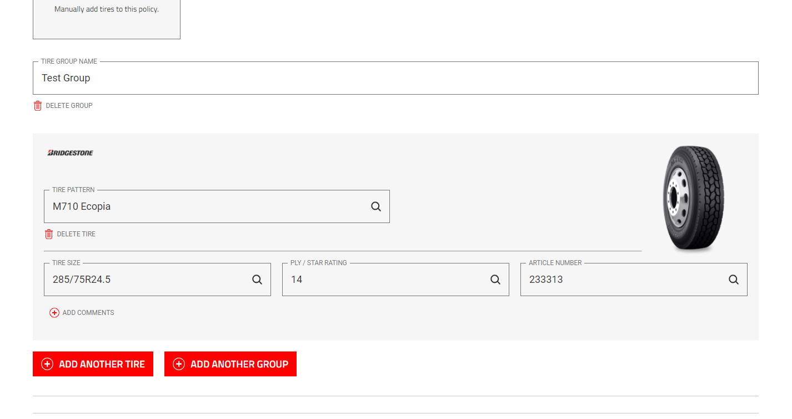
Tires can also simply be added by adding an Article Number. Keep in mind that if either Tire Pattern or Article Number is removed, all other data will be as well.

Slide 64
The quickest way to populate is to use the article number. TA does not read leading 0s when using the article number. Price per unit is BEFORE FET. The FET will be added to the price on the output. In addition, input comments identifying what wheel position and application the tire is used in. I.e. M760 is a line haul, Smartway Approved, drive tire. Any other key features specific to the customer’s application should be mentioned.

Slide 65
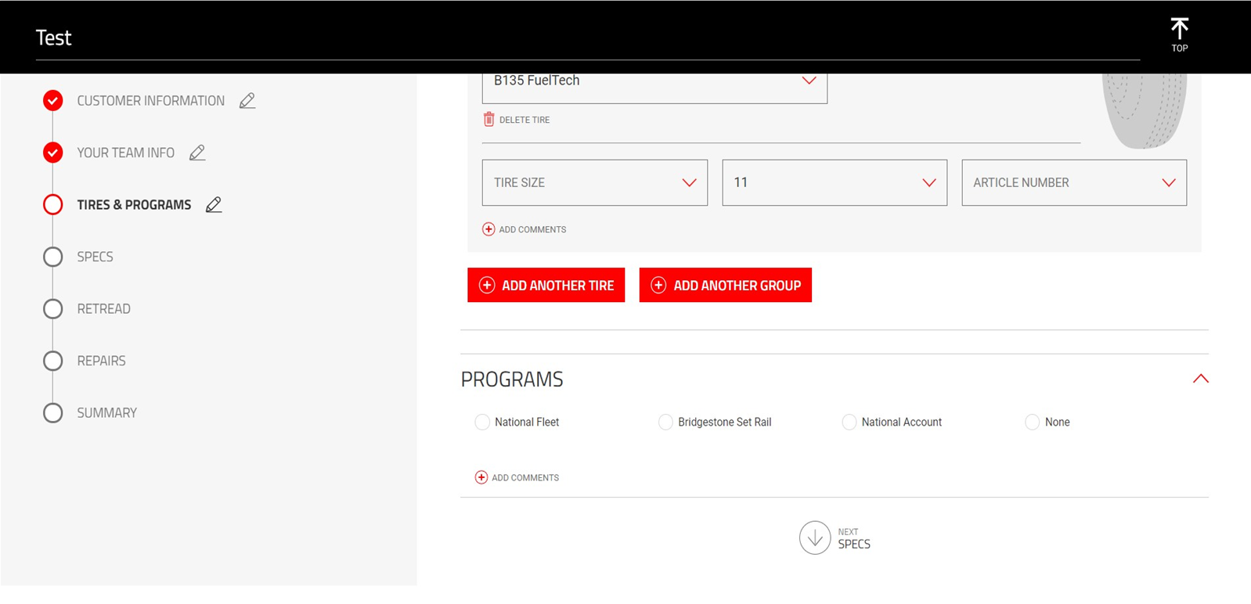
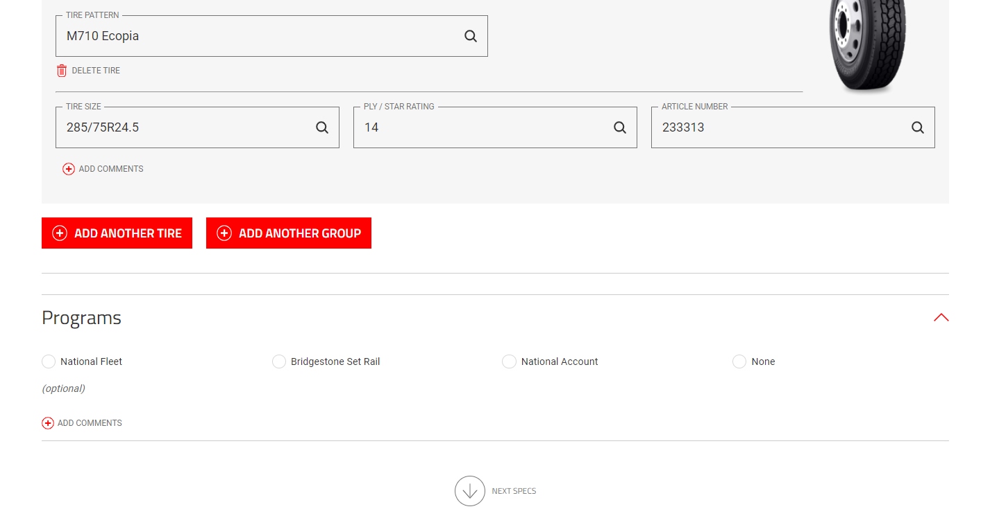
If another Tire and Group need to be added, click on the corresponding buttons and repeat the process we just went over to add Tires to the quotes.

Slide 66
Once all Tires are added to the Policy, the ability to select a Program is available. Choose one or None from the list shown and add any Comments if need. Once selections are made for the policy, click the next section, Specs.

Slide 67
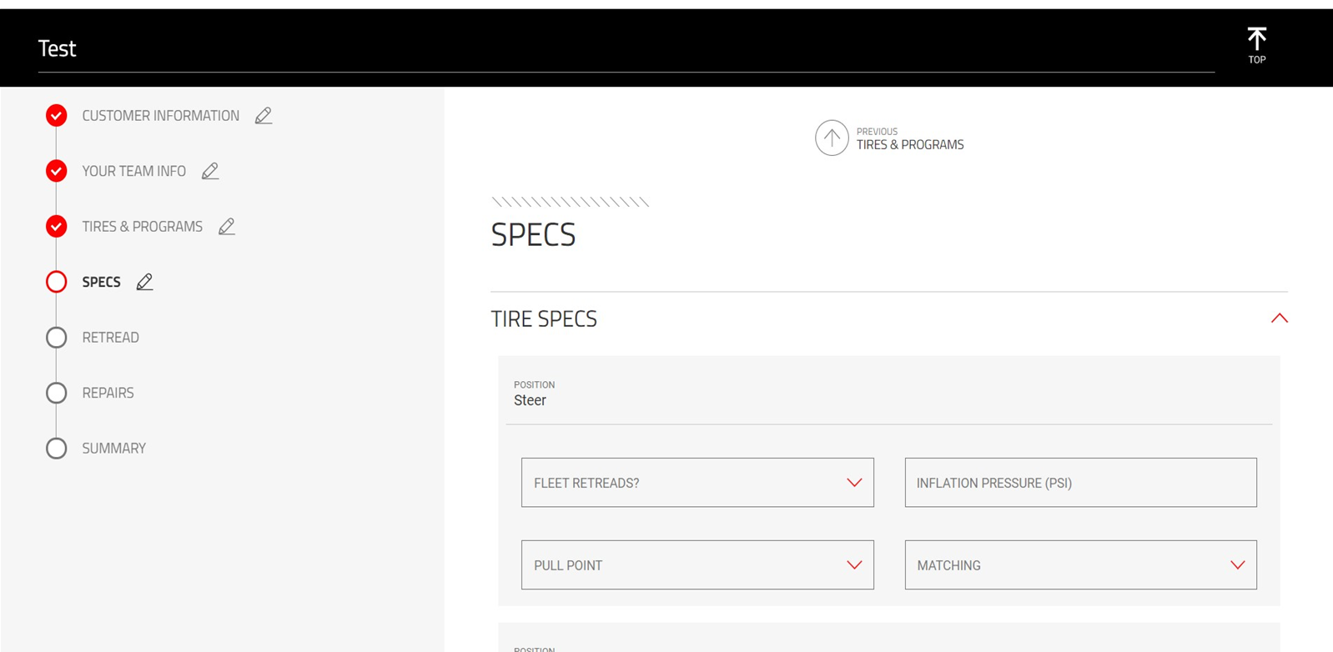
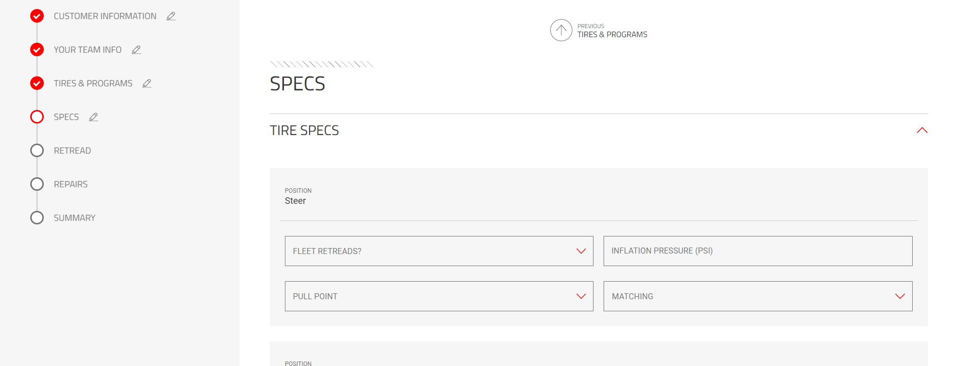
The Specs section will allow the ability to match the specs needed for the policy based on needs. It is first broken down by Tire and Tire Position. Each section will allow for different options to match the Tire Position.

Slide 68
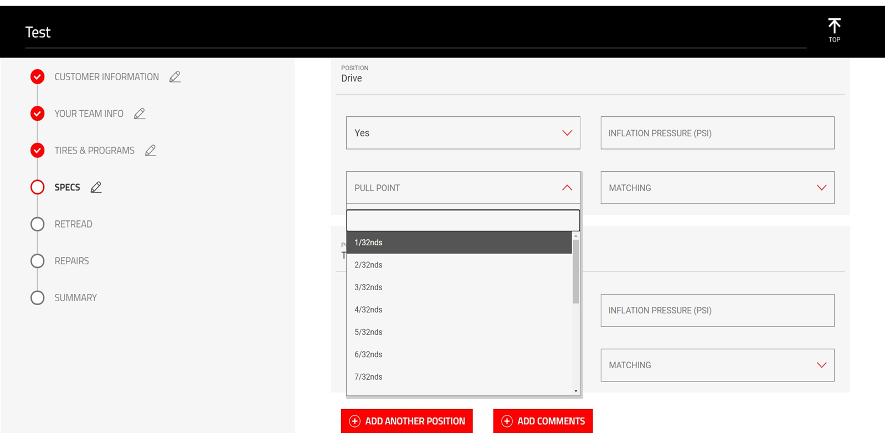
Pull Point and Matching will have options for the correct 32nds measurement. Go through each with the customer to ensure the options being selected match their needed policy.

Slide 69
Ensure the Tire Position is also matched with the information being entered in. The positions goes as follows:
Steer
Drive
Trailer
Once all are entered, add another position or comments if needed.

Slide 70
After Specs are added, there’s a series of different sections where options can be selected to include within the policy. Make sure to include what is important and be concise in the following sections. The first two sections are Matching and Inflation Instructions.

Slide 71
Continuing down, Tire Mounting is the next section. Once thing to call out is when an option is selected that includes data entry, information will have to be populated and entered.

Slide 72
The next two sections include Removal and Services & Labor.

Slide 73
Warranties and Emergency Road Services will come up next. Remember, the more information entered and selected will allow for more details on the final policy quote.

Slide 74
Wheels and Ordering & Inventory are the next two sections within Specs.

Slide 75
Balancing and Delivery are next sections to appear. Also make sure to add any Notes if needed to eliminate questions when the Policy is completed.

Slide 76
Scrap Handling and Pickup are the next two sections within Specs.

Slide 77
The last section is Pickup. Remember to Add Comments if applicable. In addition, any selection made within this section will also display on the final downloadable PDF policy. This concludes the Specs section, click on the next section Retread below.

Slide 78
Within the Retread section, the policy can add the customers retread policy based on tire position. Under each position, first select the Max Casing Age drop down.

Slide 79
Ensure we’re entering the correct information for the customer to accurately detail the policy.

Slide 80
After Casing Age, choose the Max Number of Retreads allowed for that Tire Position.

Slide 81
Make sure to go through all Tire Positions if it needs to be included within the Policy. This includes Steer, Drive, and Trailer.

Slide 82
After Tire Positions are added, Enter and select any Casing Instructions the customer needs to have followed.

Slide 83
Similar to information entered in for Specs, if a selection requires entry, more options and/or dropdowns will populate for any additional content added.

Slide 84
In this section, accepted casing brands can be selected or select all brands.

Slide 85
The last section within Retread is Casing Management. Make any selections if needed and applicable. Once all information is added, click the next section Repairs.

Slide 86
The next section will focus on repairs. Similar to Retread, each Tire Position will have it’s own set of selections and options for each type of repair. Ensure when a selection is made to use the dropdown to select the number allowed for that Tire Position.

Slide 87
Here’s a visual example of a repair being selected and the options that display below.

Slide 88
At the end of each position, a series of different options are available for Repair Instructions. Complete if applicable and add any Comments if needed.

Slide 89
After all Tire Positions are complete in regards to Repair, click the next and last section, Summary

Slide 90
The Summary will show all information added within the Policy starting with the Customer and Team Info.

Slide 91
This is followed by Tires, Programs, and Specs

Slide 92
Retread and Repairs will wrap it up, but as shown, when no information is entered or selected, the field will be blank. If a section needs to be reviewed and information added/edited, click on the section on the left and proceed accordingly. This page can always be accessed by clicking on Summary.

Slide 93
At the bottom the option to download policy is available. Download Policy will download a copy of the quote in a PDF to the computer.

Slide 94
The PDF shown will be going through changes to allow the ability to include most of the Policy on 1 – 3 pages. This concludes the Policy Manager walk through. Explore another section or click the Tire Advisor logo to go back the main home screen.

Slide 95
This section will give you the ability to use the Bundle Builder tool. More information for this can be found on Bridgestone Marketing website. Click the Tire Advisor logo to go back to the main dashboard.

Slide 96
The Search option will allow the ability to search tires, articles and other content within the Bridgestone Marketing website. The next page will display a sample search.

Slide 97
This is a visual example of a TBR Tires search resets that will display clickable information. This concludes the Search portion of the guide, click the Tire Advisor logo on the top right to go back to the dashboard.

Slide 98
The Saved section will show all saved items within Bridgestone Marketing website. This include Save Tires, Dealers, and other recommended services.

Slide 99
Scroll through favorite tires and dealers by using the Red arrow.

Slide 100
The last section will display Recommend Services and Technology to explore within the Bridgestone Marketing website. Click the Tire Adivsor logo to go back to the main dashboard.

Slide 101
Section Pending

